Slide 1

Customer Shopping Behavior Analysis
Uncovering insights from transactional data to guide strategic business decisions.

Slide 2

PROJECT OVERVIEW
Analyzing 4,000 Purchases
Data Scope
Key Goal
3,900 purchases across various product categories.
Uncover spending patterns, customer segments, and product preferences.
Strategic Impact
Guide business decisions on marketing and product positioning.

Slide 3



Dataset Summary: Key Features
Demographics
Age, Gender, Location, Subscription Status.
Purchase Details
Item, Category, Amount, Season, Size, Color.
Behavior
Discount, Promo Code, Previous Purchases, Review Rating, Shipping.
Missing Data: 37 values in Review Rating column were imputed using category median.

Slide 4


DATA PREPARATION
Exploratory Data Analysis in Python
Data Loading & Exploration
Imported dataset and checked structure/summary statistics.
Data Cleaning
Handled missing Review Rating data by imputing with category median.
Standardization
Renamed columns to snake_case for readability.
Feature Engineering
Created age_group and purchase_frequency_days columns.
Integration
Loaded cleaned data into PostgreSQL for SQL analysis.

Slide 5

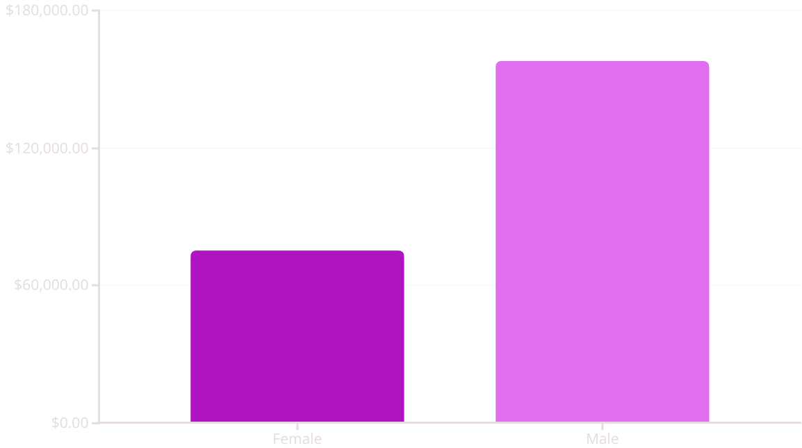
SQL Analysis: Revenue & Spending
Key Findings:
Male customers generated significantly higher total revenue ($157,890).
839 customers used discounts but still spent above average.
Express shipping users had a higher average spend ($60.48) than Standard ($58.46).

Slide 6
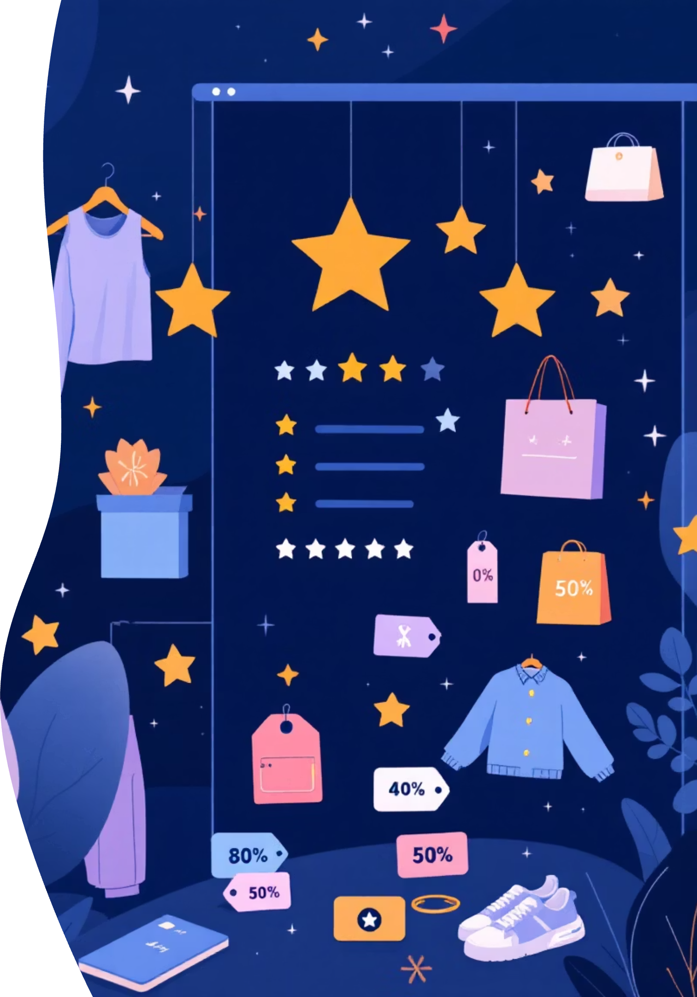
PRODUCT INSIGHTS
Top Products and Discount Dependency
Top 5 Products by Rating
Discount-Dependent Products
Gloves
50%
Avg. Rating: 3.86
Hat
Sandals
49.66%
Avg. Rating: 3.84
Sneakers
Boots
Avg. Rating: 3.82
49.07%
Hat
Coat
Avg. Rating: 3.80
48.17%
Skirt
Sweater
Avg. Rating: 3.78
47.37%
Pants

Slide 7

Customer Segmentation & Loyalty
Loyal
Returning
3,116 Customers
701 Customers
New
83 Customers
Repeat buyers (>5 purchases) are more likely to subscribe: 958 Yes vs. 2,518 No.

Slide 8

SUBSCRIPTION VALUE
Subscribers vs. Non-Subscribers
Subscription Status Comparison
Status
Total Customers
Avg. Spend
Yes
1,053
$59.49
No
2,847
$59.87
Non-subscribers have a slightly higher average spend, but subscribers represent a key loyalty segment.

Slide 9

Revenue by Age Group
Focus marketing efforts on the highest-contributing segments.
Young Adult
1
Total Revenue: $62,143
Middle-aged
2
Total Revenue: $59,197
Adult
3
Total Revenue: $55,978
Senior
4
Total Revenue: $55,763

Slide 10
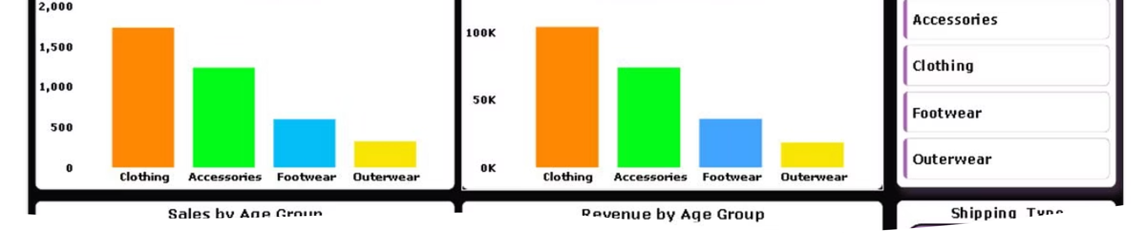
Strategic Business Recommendations
Boost Subscriptions
Customer Loyalty Programs
Promote exclusive benefits to increase subscriber base.
Reward repeat buyers to drive them into the "Loyal" segment.
Review Discount Policy
Targeted Marketing
Balance sales boosts with margin control, especially for discount-dependent products.
Focus on high-revenue age groups and express-shipping users.

